Slide 1
HTML – Meta tag ,img tag,anchor tag,semantic element,entities,attibutes

Slide 2
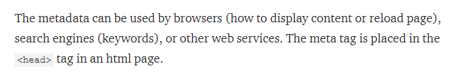

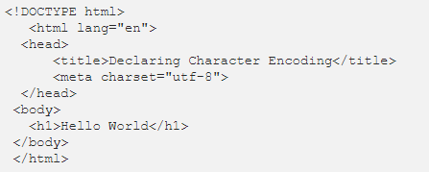

What is meta tag

Slide 3


Meta tag

Slide 4
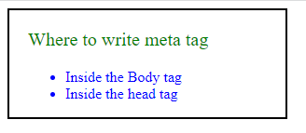
QUESTION?

Slide 5
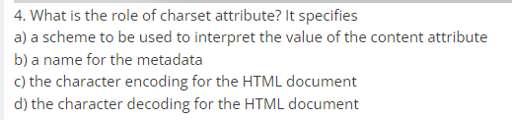
QUESTION

Slide 6
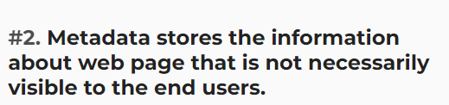
QUESTION

Slide 7
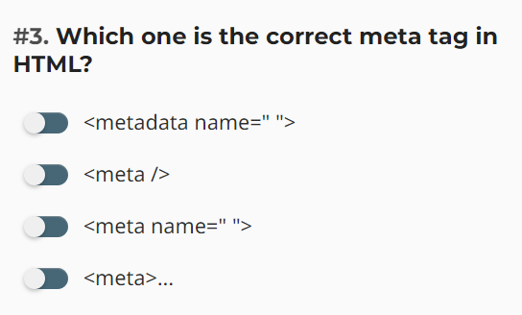
QUESTION

Slide 8
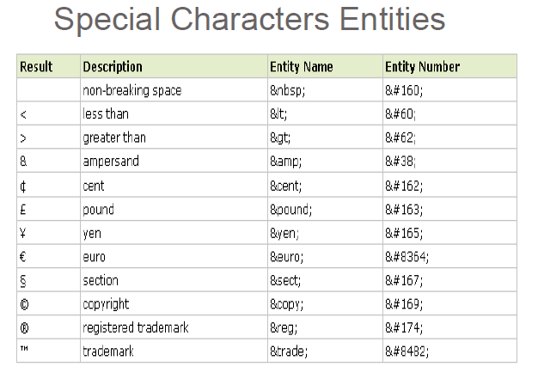


Slide 9
QUESTION

Slide 10

QUESTION

Slide 11

QUESTION

Slide 12

QUESTION

Slide 13
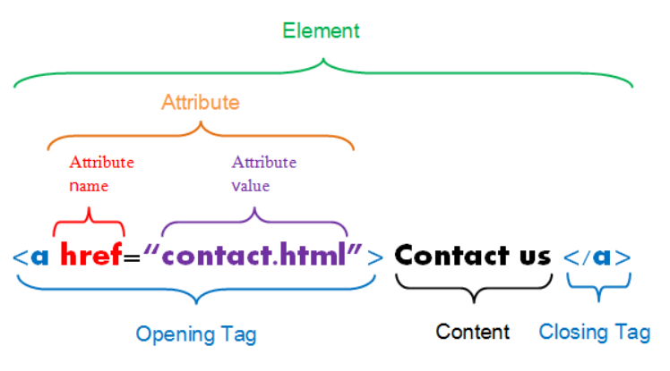
HTML ATTRIBUTE

Slide 14

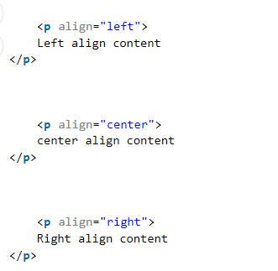



Types of attributes

Slide 15
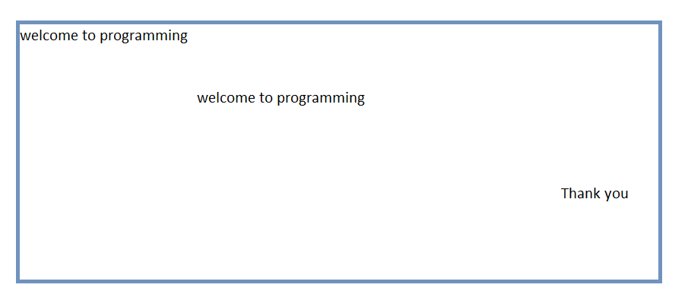
QUESTION – Attribute?

Slide 16
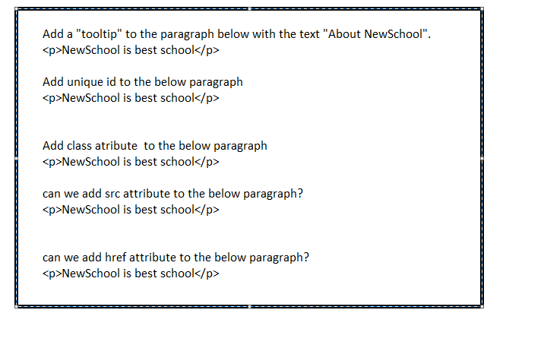
QUESTION HTML ATTRIBUTE

Slide 17
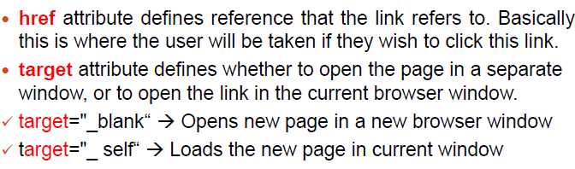
HTML Elements continue..
HTML Links
Use the <a> element to define a link
Use the href attribute to define the link address
Use the target attribute to define where to open the linked document
Use the <img> element (inside <a>) to use an image as a link
15hrs
<a href="https://www.credosystemz.com">This is a link</a>

Slide 18
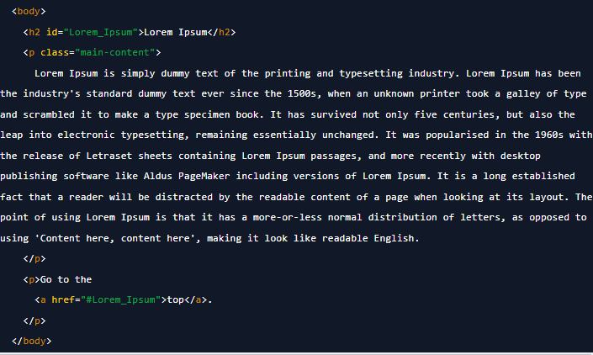
Anchor tag spcific part of the page

Slide 19
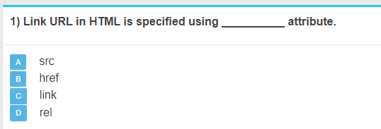
QUESTION

Slide 20
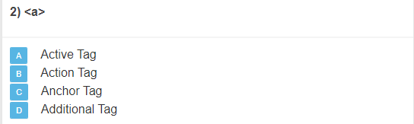
QUESTION

Slide 21
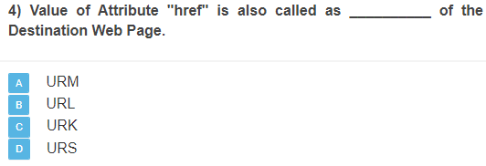
QUESTION

Slide 22
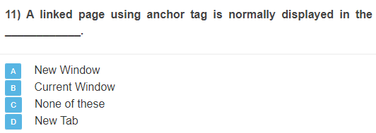
QUESTION

Slide 23
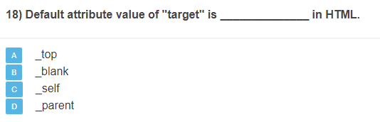
QUESTION

Slide 24
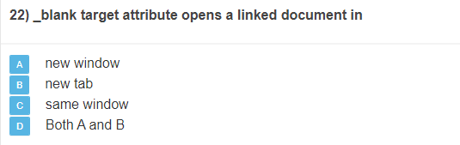
QUESTION

